Slide 1




Digital warehouse solutions
Andrew Kazachkov
The Head of Warehouse Automation and Production Practice

Slide 2

FACTS AND FIGURES
2009
We help our clients create digital products of any complexity at all stages of the cycle, from ideas to support.
Founded
Development centers
98%
Saint Petersburg
Nizhny Novgorod
Numbers
of clients are repeat customers
Completed projects
1500+
350+
Projects in progress
15+
Years in the top 100 IT companies ranking
12+
Employees

Slide 3
20+ years of experience in warehouse automation
20+
20+ years of experience in WMS development
Development of automated warehouse control systems and WCS for robots
Equipment and robots of the WCS class WMS Integration
Integration with automated equipment (Viastore shelving cranes, TGW conveyors,
KNAPP, Hanel elevators, Sorting systems, AGV, Shuttle systems, Schaefer Pick-by-light systems, scales and more )
Programming and configuration of MFC material flow control modules
Customization of various projects, including implemented by other companies
Unique retrofitting experience – modernization of legacy systems
Experience of unique non-standard logistic projects
Integration of WMS with ERP systems (1C, SAP)
Integration of WMS with Hydra MES systems
Implementation of MES functionality inside WMS
years of experience in warehouse automation
40+
projects completed
WMS
Integration
Customization
Retrofitting
Unique projects

Slide 4
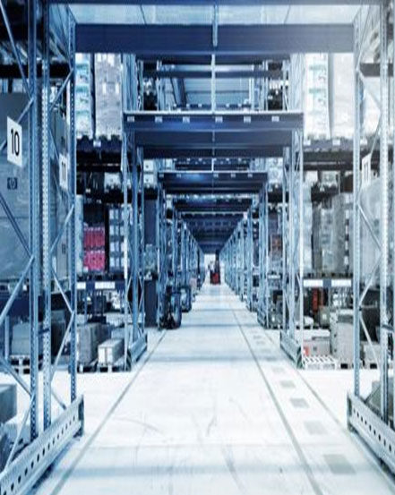
Our competencies and partnership models
WMS deep knowledge – development and implementation experience, knowledge of business processes, development
Availability of human resources, including warehouse logistics specialists
The ability to develop solutions at the edge of WMS and
other products/equipment (WCS). Integration experience with various equipment
Development of custom solutions that are not included in WMS functionality

Slide 5
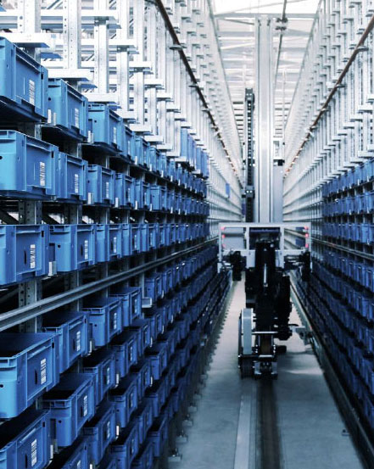
Development of automated control systems for warehouse equipment and robots (WCS)
WCS as an intermediary software between RCS robot control system and WMS warehouse management system to coordinate the materials and containers using automated equipment and robots
Integration of RCS and WMS systems using various protocols, including REST API
Integration with different warehouse equipment at the PLC level

Slide 6
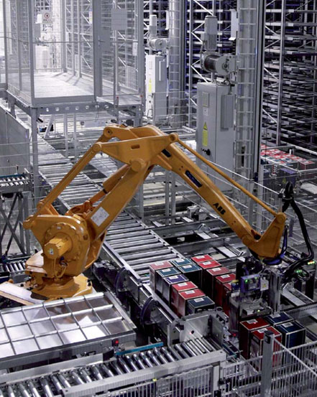
Project specifics
Conveyor integration
TKE conveyor integration including customized (TGW and others), PBL, cable cutting machine
Warehouse automation
Fully automated Kocher-Plastik, Prima
Retro-fitting
Nissan: integration with cranes and conveyors (dated 1990s) in case of documentation absence. Using a hardware telegram sniffing simulator
Damstalh: retrofitting using a software simulator. Sniffing using remote monitoring cameras for the movement of the crane
Equipment integration
Ondulus: integration with equipment (robots, sorting system, conveyors)

Slide 7
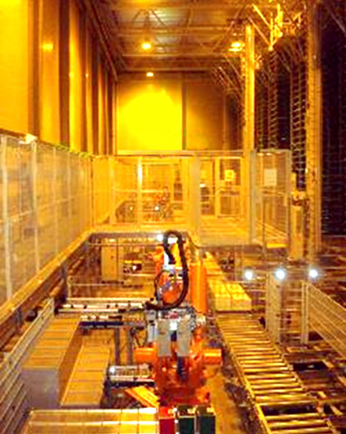
Project specifics
Crane integration
Hecker Kuhen: integration with ViaPAL, AGV cranes, automatic scanner
AGV Integration
Milchwerke: integration with AGV and automatic shuttles

Slide 8
THANK YOU!
Andrew Kazachkov
The Head of Warehouse Automation and Production Practice
Please, contact me for any questions
+7 916 696-5606
Andrey.Kazachkov@formatkoda.ru
formatkoda.ru

